Slide 1
recreate shapes with same colors.py
The goal of this python module is to get all shapes with the same color.
How does it get all shapes of the same color?
It first gets average RGB value of every shape. Then it searches every shape to determine shapes that have same color .
Once getting all the shapes with the same color, they are all put together. Next slides show you the results of executing this module.

Slide 2
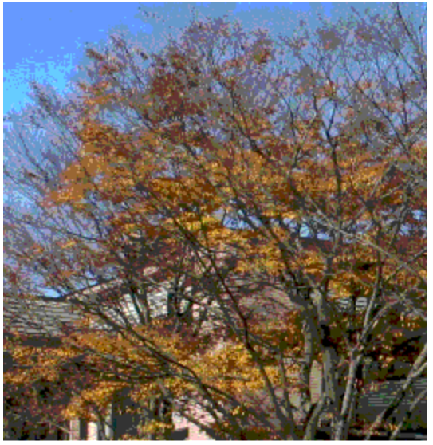
Original image

Slide 3




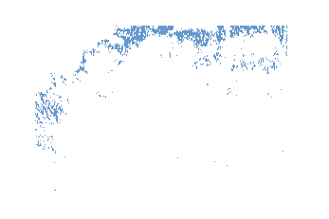
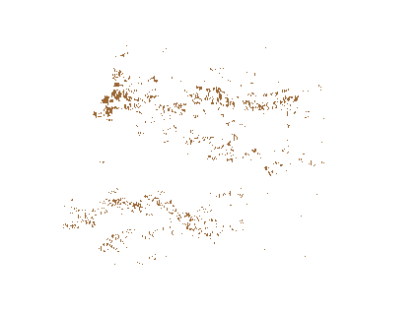
results

Slide 4
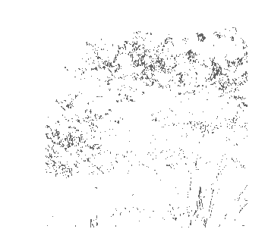
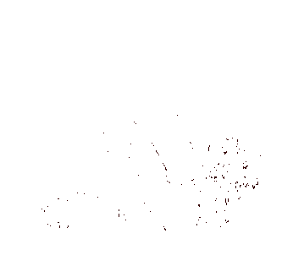

As you can see, all shapes that have the same color are put together.

Slide 5
Finding shapes with brightness change
Modules to execute
find shapes brightness change.py
recreate shapes with brightness change.py
Prerequisites:
finding_shapes.py
To execute two modules, make sure you have run prerequisite module first.

Slide 6

Demonstration
For testing purposes, I created this image with
Nothing but brightness change. It first starts with
Rgb value of (10, 10, 10) then the image increases
by ( 10 + 8, 10 + 8 , 10 + 8 ).

Slide 7
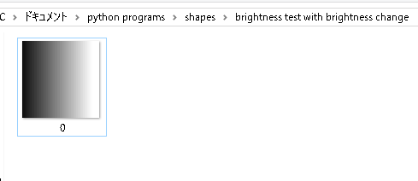
If the test goes through as expected, the two brightness change detection modules ( which I showed earlier should create exactly the same image since this image consists of nothing but brightness change.
And the result is this one on top. It recreated the same image as the original

Slide 8
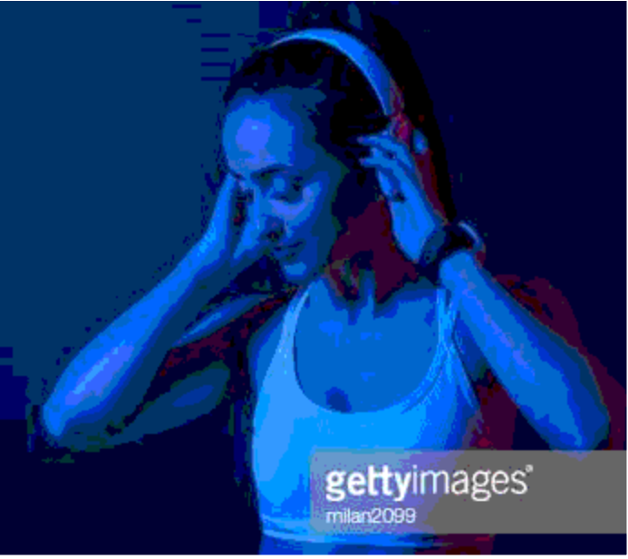
Now we try with this image

Slide 9
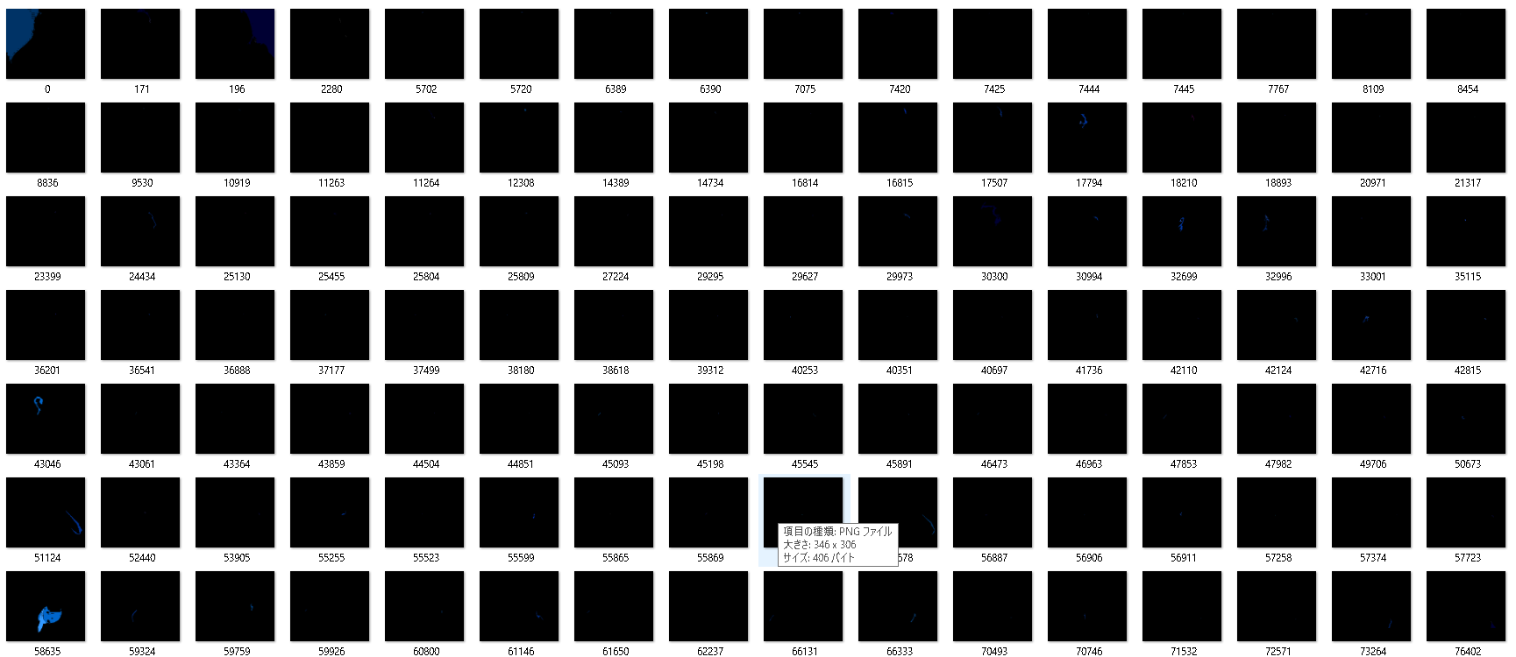
Results…

Slide 10



As you can see, results are disappointing! But not because the algorithm failed but because this image does not have so much brightness change.
But the algorithm for detecting brightness change is absolutely necessary for object recognition. It needs to be combined with other algorithms or my brightness change algorithm needs some more improvements, which will be my plans in the future!

